Slide 1
Architectural changes in SharePoint 2013
Name
Title
Company

Slide 2

Agenda
Agenda
Shredded Storage
SQL Improvements
Cache Service
Request Management
Service Applications
Office Web Apps
Analytics
Social Changes
Other Considerations

Slide 3
Storage and SQL Improvements

Slide 4
Shredded Storage
The goal is to make changes equal to the size of the change, not size of the file
How It Works in SharePoint 2010:
When a file is updated via Cobalt, only the bits that have changed are sent over the wire from the client to the SharePoint WFE. However, because SharePoint lacks the concept of incremental updates to SQL we are forced to:
pull the entire file to the WFE
merge the changes into it
write the entire file back to SQL

Slide 5
Shredded Storage
How It Works in SharePoint 2013:
We break the file into pieces and store that in SQL
On update we only touch the shredded blobs that correspond to the updated bits
No more round tripping entire files to the WFE and back

Slide 6





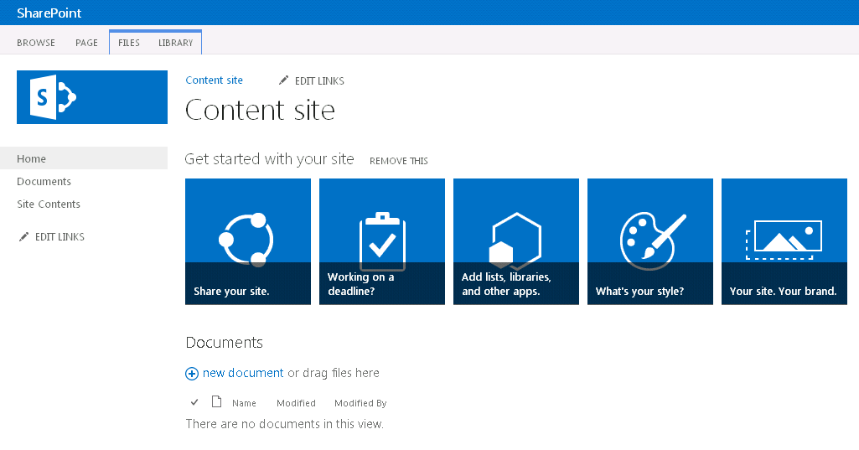
Document Updates in SharePoint 2010 with Cobalt
WFE Requests Document
User Requests Document
WFE Reads Full Document from SQL
Full Document is Written to SQL
User Updates Document
Updates are Sent to WFE
SQL Reads Full Document
Updates are Merged

Slide 7
Document Updates in SharePoint 2013 with Cobalt
WFE Requests Document
User Requests Document
User Updates Document
Updates are Sent to WFE
Updates are Committed to SQL “Shredded Storage”
Updates are Sent to SQL
SQL Reads Full Document

Slide 8
SQL Improvements
We’ve reduced scenarios that might invoke full table scans
There have been lots of improvements around finding docs for link fix-up and alert handling
Reduced data redundancy for some features
Using advanced indexing features provided by SQL 2008 R2
Changes in architecture to support wide lists, i.e. lists where a single item spans multiple rows in the database to hold the data

Slide 9
Cache Service

Slide 10
Cache Service
There is a new distributed cache service in SharePoint 2013 based on Windows Server AppFabric Distributed Caching
It is used in features like authentication token caching and My Site social feeds
SharePoint 2013 uses caching features that cloud-based cache (Windows Azure Cache) does not support at this time, so only local cache hosts can be used
SharePoint ONLY supports the version of caching that it ships – you cannot independently upgrade it.

Slide 11
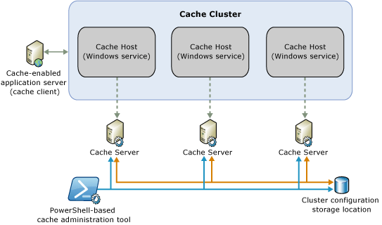
Cache Service
The config DB keeps track of which machines in the farm are running the cache service
It is all provisioned by SharePoint setup
A new Windows service – the Distributed Cache service – is installed on each server in the farm when SharePoint is installed
The management details of the Cache service are covered in the Farm Planning session

Slide 12
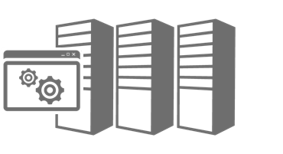
Distributed Cache in SharePoint 2013 (Default Config)
Distributed Cache service (Windows service)
Distributed Cache service (Windows service)
Distributed Cache service (Windows service)
Distributed Cache service (Windows service)
Other Service Apps
Distributed Cache service (Windows service)
Other Service Apps
Distributed Cache service (Windows service)
Other Service Apps
Cluster configuration stored in config DB

Slide 13
Request Management

Slide 14
Request Management (RM)
The purpose of the Request Management feature is to give SharePoint knowledge of and more control over incoming requests
Having knowledge over the nature of incoming requests – for example, the user agent, requested URL, or source IP – allows SharePoint to customize the response to each request
RM is applied per web app, just like throttling is done in SharePoint 2010
RM is turned off by default

Slide 15
RM – Goals
RM can route to WFEs with better health, keeping low-health WFEs alive
RM can identify harmful requests and deny them immediately
RM can prioritize requests by throttling lower-priority ones (bots) to serve higher-priority ones (end-users)
RM can send all requests of specific type, like search for example, to specific machines
Isolated traffic can help troubleshoot errors on one machine
RM can send heavy requests to more powerful WFEs

Slide 16
RM Components
Request Manager (RM)
Request Throttling and Prioritization
Filter out requests that should be throttled or prioritized
Request Routing
Select which WFE’s the request may be sent to
Request Load Balancing
Select a single WFE to route to, based on weighting schemes like health

Slide 17
RM Routing and Pools
Routing rules route requests and are associated with MachinePools
MachinePools contain servers
Servers use weights for routing – static weights and health weights
Static weights are constant for WFEs; health weights change dynamically based on health scores
Machine Pool “Ignite”
Routing Rule #1
Routing Rule #2
…
Routing Rule #n
Static Weight = 1
Health Weight = 4
Static Weight = 1
Health Weight = 4

Slide 18
RM Routing Rules
Routing to a server in a MachinePool is based on matching a routing rule
Routing rules are placed in ExecutionGroups
These are numbered 0 to 2, with 0 the default
Rules are evaluated in each ExecutionGroup
As soon as a match is found no more ExecutionGroups are evaluated
All machines from pools that match any routing rules are union’ed together to determine possible target servers
This means that you create your most important rules in ExecutionGroup 0

Slide 19
Routing Rules and Execution Groups
Execution Group 1
Machine Pool 3
Routing Rule #4
Machine Pool 1
Routing Rule #5
Execution Group 0
Routing Rule #1
Routing Rule #2
X
Match!
Machine Pool 1
Execution Group 2
Machine Pool 2
Routing Rule #6
Routing Rule #3
Machine Pool 3
No Match
Routing Rule #7
Not Evaluated

Slide 20
RM Routing Rules (cont.)
There are some important caveats to remember about routing rules
If no rules are matched, then the request will get routed to any available routing target
If you want to route everything to a subset of machines, make a rule with no criteria and specify the subset of machines you want to routed to

Slide 21
RM – Why Not Throttling?
SharePoint 2010 has throttling but there is room for improvement
Uses a health score system in which WFEs attach their health info to all responses
The drawbacks from this approach were:
It was the clients’ responsibility to honor the health scores
It did not preclude WFE failure
Clients could be shown server busy messages from a poor-health WFE when other better-health WFEs were available

Slide 22
RM Throttling Rules
Routing rules process requests; throttling rules stop requests
It’s much like throttling in SharePoint 2010, only more sophisticated
You create criteria for the throttling rule, and if the criteria is met the request is throttled
The process and PowerShell for creating throttling rules is very similar to routing rules

Slide 23
Criteria's You Can Use for Routing and Throttling
Rules can match on these properties:
Url
UrlReferrer
UserAgent
Host
IP
HttpMethod
SoapAction
CustomHeader
You can evaluate values using these methods:
StartsWith
EndsWith
Equals
RegEx

Slide 24
RM Scenario – Heavy Client Application
You have a heavy load on the system with many browser requests. Notebook sync requests start coming in from OneNote. The OneNote requests start adversely affecting the browser requests so a throttling rule is added to deny OneNote requests:
Rule: Deny requests with UserAgent of regex = “.*Microsoft Office OneNote 2010*”
Based on this rule RM denies OneNote requests. When system load dies down, the admin can remove the throttling rule
Other Options:
Rule could use an expiration to automatically deactivate the rule at a certain time
Rule could use a health score threshold to activate

Slide 25
RM Routing Weights
RM uses static weights and health weights
Static weights are associated with WFEs so certain ones will always be favored when selecting.
This gives added weight to more powerful WFEs and less to weaker machines
Health weights are used to even out load and keep “sick” WFEs going
Health scores run from 0 to 10 where 0 is the healthiest and therefore will get the most requests; this score is used to derive the health weight
WFEs start with a healthy weight; the Policy Engine health rule updates health weights dynamically – you cannot change it manually

Slide 26
RM Scenario – Health Based Routing
A series of requests come in; one WFE is in poor health, while two others are in good health. RM evaluates the following:
Health information: { [WFE1, sick], [WFE2, healthy], [WFE3, healthy] }
Based on this RM routes most of the requests among WFE2 and WFE3
It is still random routing, but greater weight is given to healthier machines
Alternatively the admin could remove WFE1 from the routing pool, allow it to complete its requests then return it back to the pool

Slide 27
Service Application Changes

Slide 28
Service Application Changes
There are a few new service applications in SharePoint 2013:
App Management Service: allows you to install SharePoint apps from the Office Marketplace or the App Catalog
SharePoint Translation Services: does simple language translation of Word, PPT, and XLIFF files into HTML
Work Management Service: provides task aggregation across systems such as SharePoint, Exchange and Project
Workflow Manager is new and not really a service app but similar; provides an externalized host using REST and OAuth to run workflows
Office Web Apps is no longer a service application
Web Analytics is no longer a service application

Slide 29
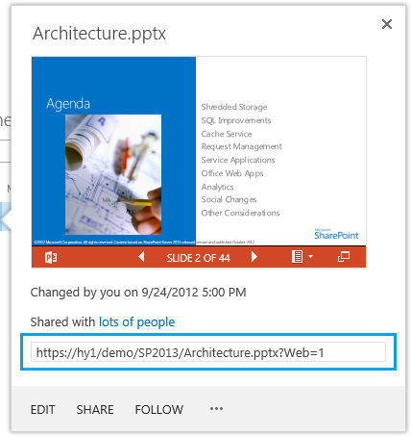
Office Web App URLs in SP 2013
URLs have been cleaned to be human friendly and understandable:
From this:
http://office/2013/collab/Demo/_layouts/PowerPoint.aspx?PowerPointView=ReadingView&PresentationId=/2013/collab/Demo/Docs/wac.pptx&Source=http%3A%2F%2Foffice%2F2013%2Fcollab%2Fdemo%2Fdocs%2FTraining%2520Module%2Fdocsethomepage%2Easpx%3FID%3D96%26FolderCTID%3D0x0120D52000DC71A13124DA5249ACA958C4DFD092C90037E1F59EB352013B4F940A3806D9B183F0%26List%3Dc910e954%2D68ca%2D42ae%2Dbb0f%2D1c6908c73e77%26RootFolder%3D%252F2013%252Fcollab%252Fdemo%252Fwac%25202013&DefaultItemOpen=1
To this:
http://office/2013/collab/Demo/Docs/wac.pptx?Web=1

Slide 30
Office Web Apps Architecture
OWA is now a separate server product, not a service application
You can create an OWA farm that can support multiple SharePoint farms
You can view files from a number of different data sources, including:
SharePoint
Exchange
Lync
File servers
3rd parties can integrate with OWA to provide access to documents in their data stores, e.g. EMC Documentum, IBM FileNet, OpenText, etc.

Slide 31
Office Web Apps Architecture (cont.)
This allows you to scale and manage OWA separately from other Microsoft server products, as well as share that infrastructure between them
OWA farm version does not need to be in sync with SharePoint farm
You connect your SharePoint farm to the OWA farm using PowerShell
NewSPWOPIBinding

Slide 32
New Replacement for Web Analytics Service
The Analytics Platform replaces the Web Analytics service application
Some of the reasons for that included:
There was no concept of item-to-item recommendations based on user behavior, i.e. people who viewed this also viewed that
Couldn’t promote search results based on an item’s popularity (as determined by # of times an item was viewed)
It required a very powerful SQL box and significant storage and IO
Lists don’t have explicit view counts
The architecture had problems scaling to large numbers

Slide 33
How the New Platform Improves on Analytics
The new Analytics Processing engine aims to solve these issues:
Find relevant information (improve search relevance) – based on views, click thru, etc.
See what others are looking at (“hot” indicators and usage numbers – i.e. what’s popular based on # of views as well as # of unique users to view)
Understand how much content is being used (i.e. viewed) and how it compares to other documents
See discussion thread usage and find the hot topics
Use this popularity info to populate views through the Content by Search (CBS) WebPart
The model is extensible for 3rd parties to build into the platform

Slide 34
Processing and Storing Analytics Data
Data goes through an analysis and reporting process that is contained within the search service application
Things like views and counts are combined with click-thru and other search metrics and pushed into the reporting database
Some data like view counts are also pushed into the index so it can be included in search results, sorted on (i.e. what’s most viewed), etc.
An analytics processing job examines data for clicks, links, tags, etc., as well as the usage data to create the data points used for reporting

Slide 35
Analytics
Demo

Slide 36
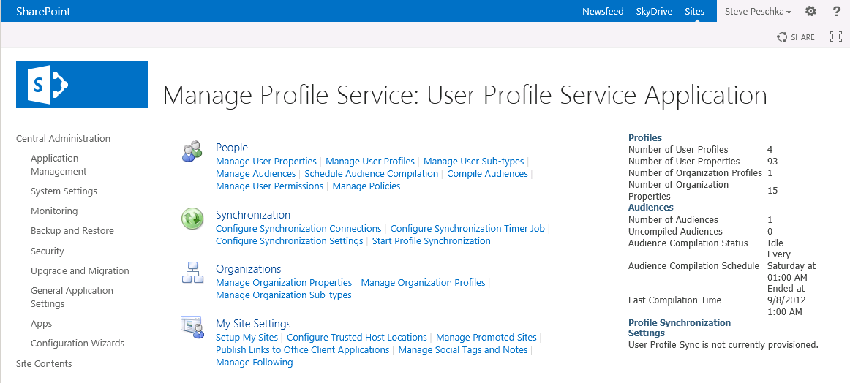
Social Changes
Much more detail on social in the presentation on Social features, but worth highlighting:
User Profile Replication Engine
Profile Sync Changes
My Site Data Store Changes

Slide 37
SharePoint 2013 User Profile Replication Engine (UPRE)
In SharePoint 2013 the UPRE has had ownership given back to the SharePoint Base team
It has been more like a toolkit deliverable in the past and has suffered some reliability issues
Bringing it in with core Product Group ownership will ensure it gets the right developers and testing applied to it
UPRE is available as a separate download on the web

Slide 38
Profile Sync Performance Improvements
Performance improvement goals are to reduce full import time from 2 weeks down to 60 hours for very large directories (i.e. 200K users, 600K groups)
One piece of anecdotal evidence: 300K users, less than 7 hours for full import; previously it took nearly three weeks
Some of those improvements included:
Adding indexes to certain user properties that eliminated full table scans
Importing data from BDC in batches rather than one by one
Removing unused provisioning steps
Cleaning up unused historical data
Move resolution of some objects out of SharePoint and into the sync system

Slide 39

New Profile Synchronization Option
Active Directory Direct Import
Active Directory forest with multiple domains, one connection per domain
Selection of OUs from which to import
Import User and Group objects
Simple text-filters written in LDAP syntax
Full and incremental import
You can switch back between FIM and AD Direct

Slide 40
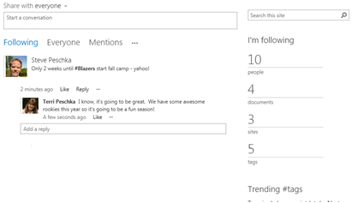
Changes in Social Data Store
The store for social data now is your personal site now – it’s no longer in the social DB
That means that social feeds will now come out of the content DB for My Sites
That gives you much more power to scale
social features than SharePoint 2010
Single Social DB could become an I/O bottleneck
in SharePoint 2010
It also means that My Sites are required for some social features, including feeds

Slide 41
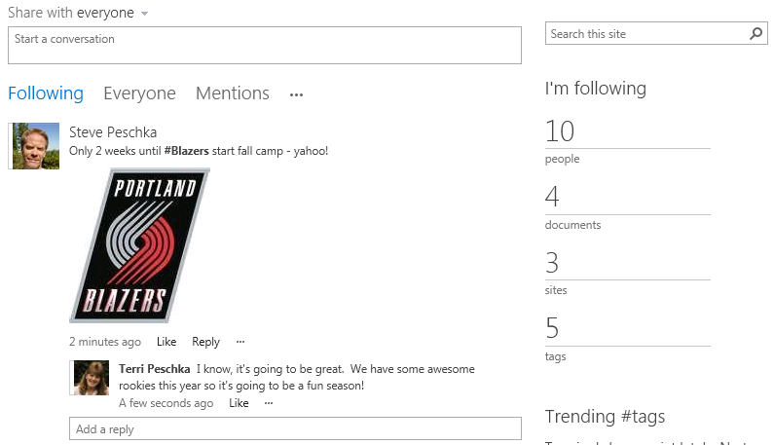
Changes in Social Data Store
The store for social data now is your personal site now – it’s no longer in the social DB
That means that social feeds will now come out of the content DB for My Sites
That gives you much more power to scale
social features than SharePoint 2010
Single Social DB could become an I/O bottleneck
in SharePoint 2010
It also means that My Sites are required for some social features, including feeds

Slide 42
Other Considerations
Stretched farms are no longer supported in SharePoint 2013
“Stretched” means different data centers with less than 1ms latency
All servers in the farm, including SQL, must be in the same physical building now
For 100% fidelity in 100% of features, we recommend you have only one User Profile service application (UPA) in your enterprise
Certain social features will have a very slightly degraded experience unless:
There is only one enterprise UPA
All server farms are connected to it by local network – consuming UPA over a WAN is not supported
It is our goal to provide support for all Social features in a multiple UPA deployment soon after release; we are targeting the first half of 2013 to provide an update for this support

Slide 43
Agenda
Summary
Shredded Storage
SQL Improvements
Cache Service
Request Management
Service Applications
Office Web Apps
Analytics
Social Changes
Other Considerations

Slide 44
Q&A

Slide 45

© 2012 Microsoft Corporation. All rights reserved. Microsoft, Windows, Windows Vista and other product names are or may be registered trademarks and/or trademarks in the U.S. and/or other countries.
The information herein is for informational purposes only and represents the current view of Microsoft Corporation as of the date of this presentation. Because Microsoft must respond to changing market conditions, it should not be interpreted to be a commitment on the part of Microsoft, and Microsoft cannot guarantee the accuracy of any information provided after the date of this presentation. MICROSOFT MAKES NO WARRANTIES, EXPRESS, IMPLIED OR STATUTORY, AS TO THE INFORMATION IN THIS PRESENTATION.

